Slide 1






Introduction to
Argumentative Essay
LCC113 Resource Team

Slide 2




What is an argumentative essay?
An argumentative essay requires students to argue opinions using logical evidence about a certain topic, focusing on arguing for a specific perspective.
It poses an argument and tries to persuade readers to agree by using supporting facts and information.
Because of its reliance on structure and planning, the first step in writing one is often drafting a solid argumentative essay outline.

Slide 3







When writing an argumentative essay…
01.
02.
03.
Clarity
Support
Arrangement
Clearly state your perspective on the issue: in full agreement/in partial agreement/completely different.
Support your ideas with reasoning and examples.
Organize your ideas clearly and logically.

Slide 4


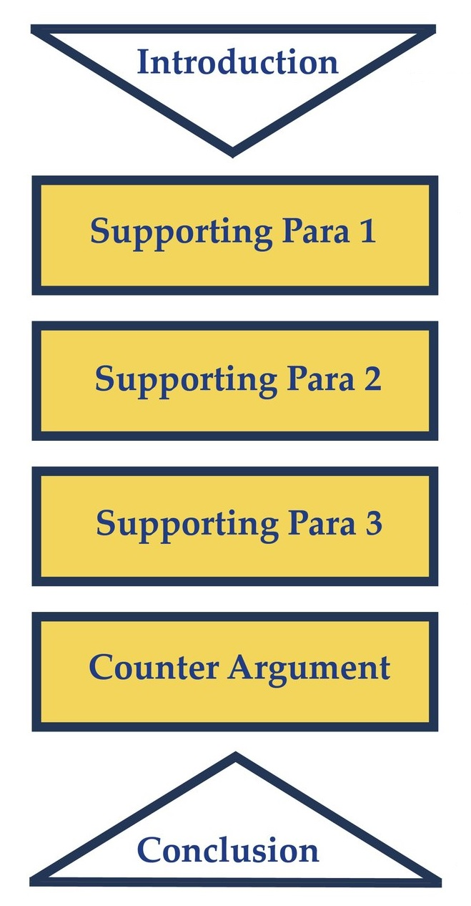

Structure of an argumentative essay:

Slide 5


The introduction
The introduction of any essay is very important for one reason: this is your first impression. You want to grab the reader’s attention and make them keep reading and paying attention. Including a catchy hook in your introduction isn’t a bad idea.
Your introduction should always close with your thesis statement. The thesis statement will clarify your stand on the issue.

Slide 6

Thesis Statement
A thesis statement is a concise, usually one-sentence, summary of the overarching point you’ll be making throughout the essay. If your essay is arguing that cats are better pets than dogs, then this is the type of broad information that you’ll want to include in your thesis statement. Make sure that the reader knows exactly what the broad topic of the paper will be.

Slide 7

Supporting Paragraphs
This is where you’ll attempt to persuade the reader to believe your perspective. A rule of thumb for essay writing is that you want to try to have 3 supporting paragraphs. In these paragraphs, you’ll want to use concise facts and supporting information — the more specific the better! If you’re arguing that cats are better pets than dogs, you might have one supporting paragraph that focuses on the level of independence of cats, one that discusses the high intelligence level of cats, and a third that examines a cat’s lifespan. (These are just examples off the top of my head - there could be so many more reasons that cats are better than dogs, or why dogs are better than cats!)

Slide 8
Supporting Paragraphs (cont.)
To prove your argument. Usually is one paragraph but it can be longer.
Topic Sentence: What is one item, fact, detail, or example you can tell your readers that will help them better understand your claim/paper topic? Your answer should be the topic sentence for this paragraph.
Explain Topic Sentence: Do you need to explain your topic sentence? If so, do so here.
Introduce Evidence: Introduce your evidence either in a few words (As Dr. Brown states ―…‖) or in a full sentence (―To understand this issue we first need to look at statistics).
State Evidence: What supporting evidence (reasons, examples, facts, statistics, and/or quotations) can you include to prove/support/explain your topic sentence?
Explain Evidence: How should we read or interpret the evidence you are providing us? How does this evidence prove the point you are trying to make in this paragraph? Can be opinion based and is often at least 1-3 sentences.
Concluding Sentence: End your paragraph with a concluding sentence that reasserts how the topic sentence of this paragraph helps up better understand and/or prove your paper’s overall claim.

Slide 9


Supporting Paragraphs (cont.)
Counter argument/opposing viewpoints
A great argumentative essay will demonstrate an understanding of and respect for different viewpoints than one’s own. They want to see that you can argue a point, but they also want to see that you understand why someone may believe something different than you do.
A good place to put this paragraph is right after your supporting paragraphs and before your conclusion. For my essay about cats and dogs, here is where I would write a brief paragraph discussing why some people prefer dogs over cats. I would then gently refute this perspective and lead into my conclusion.

Slide 10
Supporting Paragraphs (cont.)
Counter argument/opposing viewpoints
Explain the reasoning of the opposing side. Point out their defenses and evidence—what would they say if they were writing the essay?
Point out weaknesses and inconsistencies in their argument
Refute their points with evidential support (known as refutation)
Reinforce your position as the more reasonable position

Slide 11

Supporting Paragraphs (cont.)
Counter argument/opposing viewpoints
Show Why the Other Side Is Weak
When writing your essay, you may be tempted to ignore the other side of the argument and just focus on your side, but don’t do this. The best argumentative essays really tear apart the other side to show why readers shouldn’t believe it. Before you begin writing your essay, research what the other side believes, and what their strongest points are. Then, in your essay, be sure to mention each of these and use evidence to explain why they’re incorrect/weak arguments. That’ll make your essay much more effective than if you only focused on your side of the argument.

Slide 12

The
Conclusion/Recap
In your conclusion you want to offer a broad recap of your point. Restate your thesis using different wording, and wrap up the essay nicely by summarizing your entire point.

Slide 13

References
https://www.thepreparedstudent.com/blog/act-writing-how-to-write-a-good-essay
https://www.grammarly.com/blog/argumentative-essay-outline/
https://depts.washington.edu/owrc/wp-content/uploads/2021/05/Argumentative-Paper-Format.pdf
https://blog.prepscholar.com/argumentative-essay-examples
https://www.masterclass.com/articles/how-to-write-a-good-argumentative-essay#610z6pqUuo6p0Ky69TDqB1

Slide 14






Thank you!
LCC113 Resource Team

